Slide 1
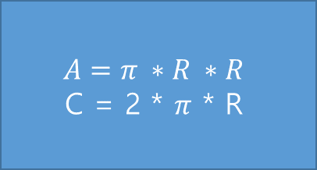
START
p. 61
R, A, C
READ R
$$A=π ∗R ∗R$$
C = 2 * $π$ * R
A, C
END

Slide 2
START
p. 64
NO, A, C, D
READ
NO, C, D
A = C * D
NO, A
END

Slide 3
p. 66
start
A, B, C, TEMP
READ A, B, C
TEMP = B
B = A
A = C
C = TEMP
END

